Slide 1
2010 WWII Monument Projects

Slide 2
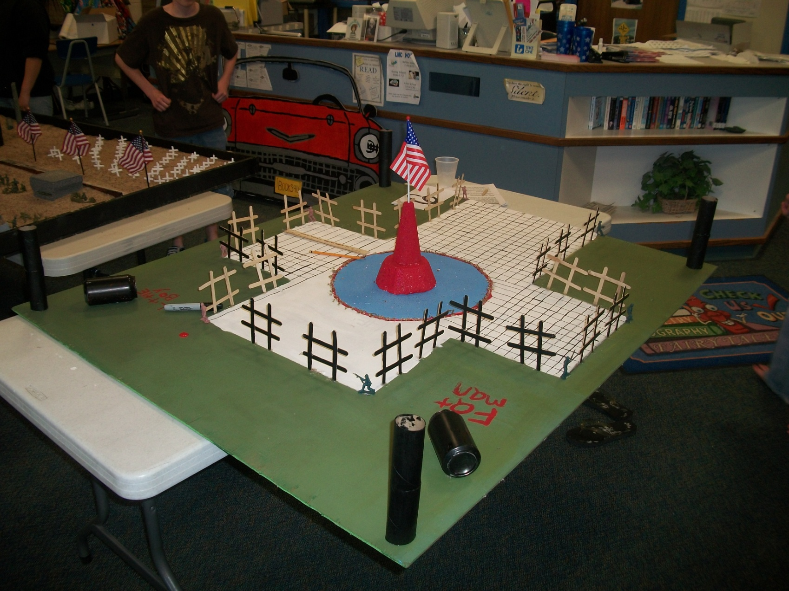
6th Place

Slide 3
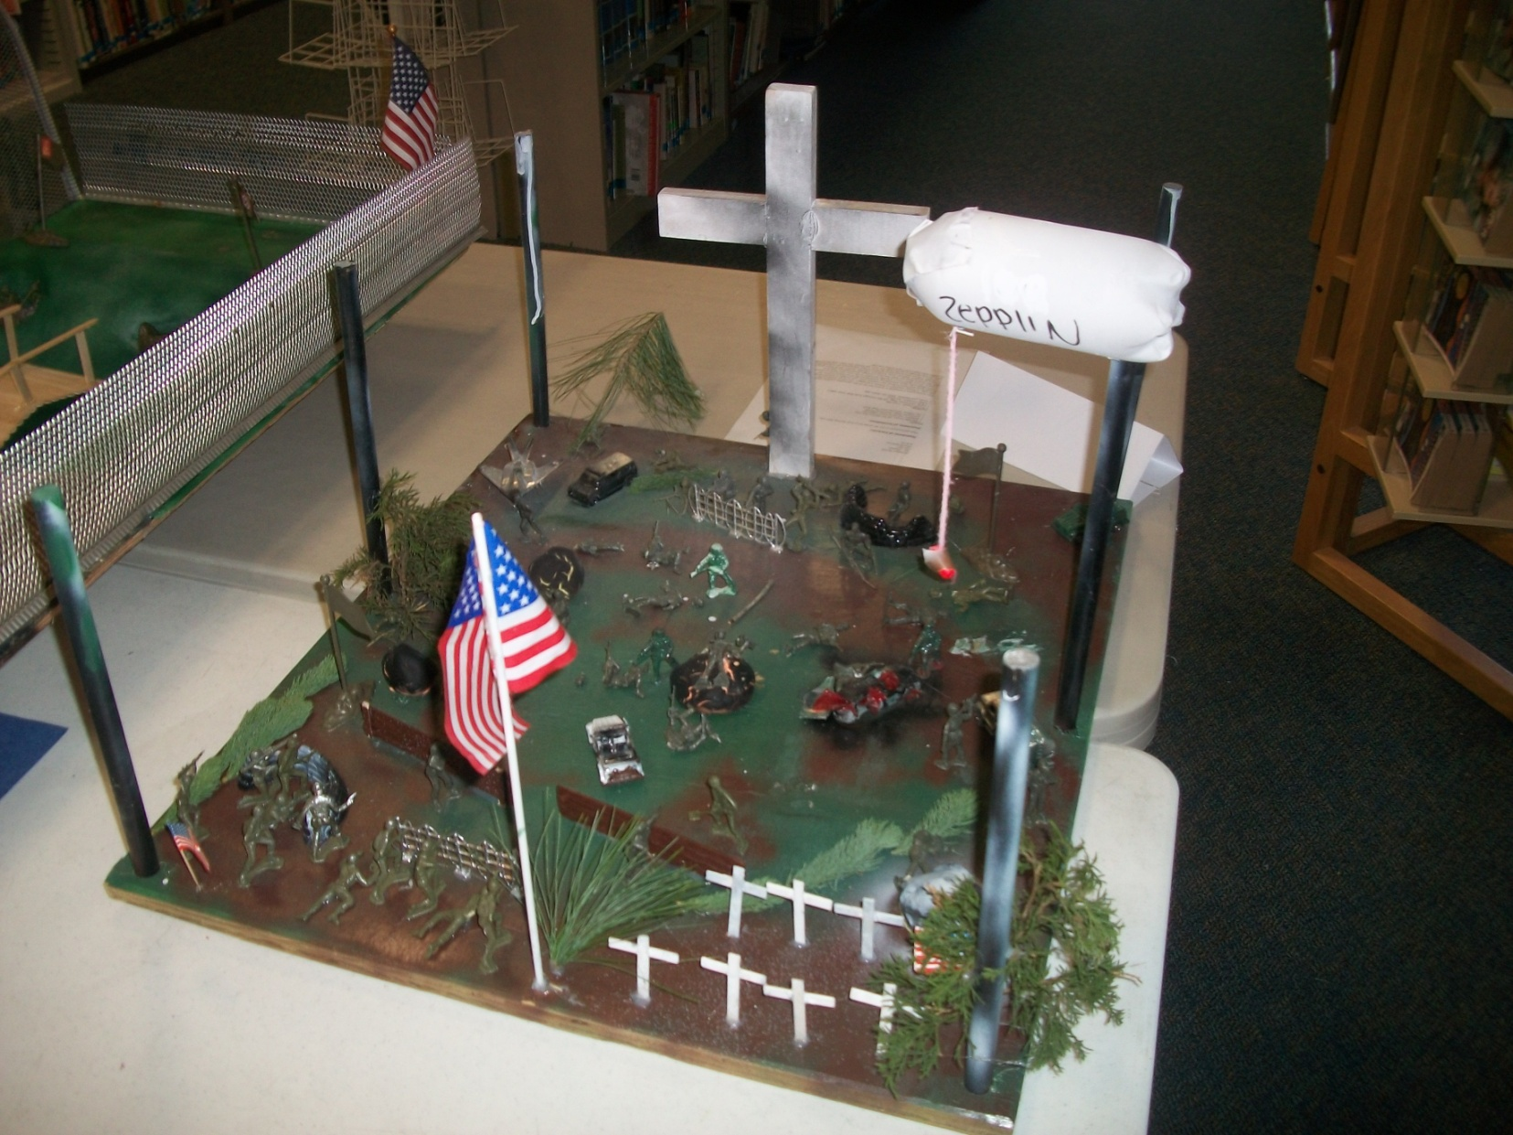
5th Place

Slide 4
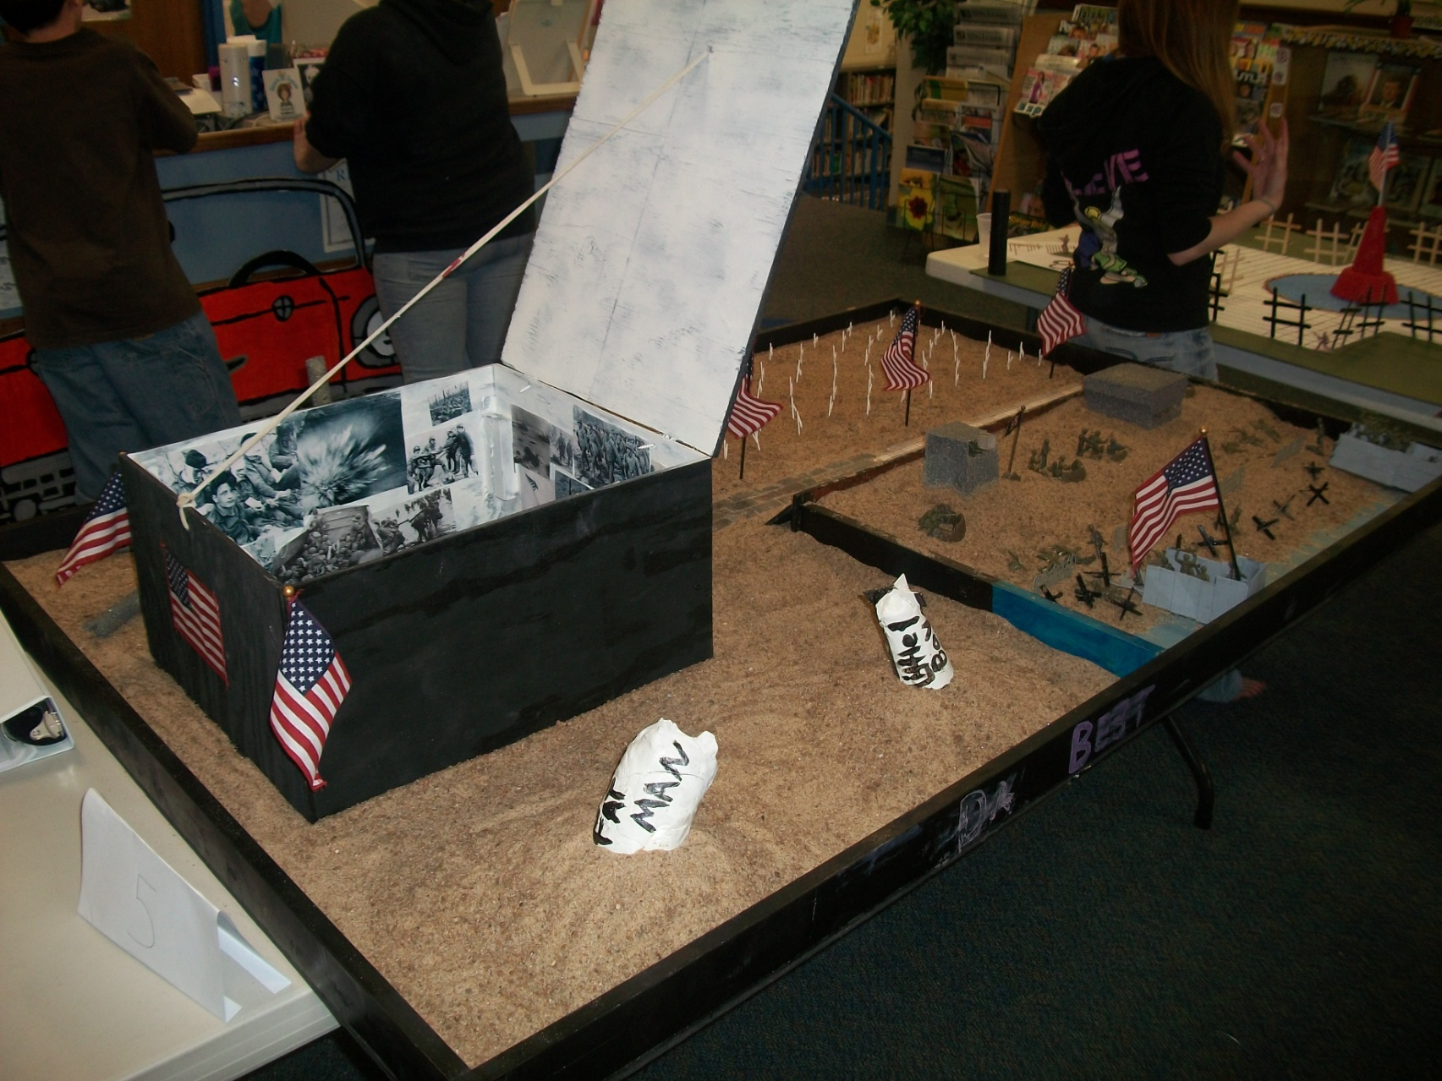
4th Place

Slide 5
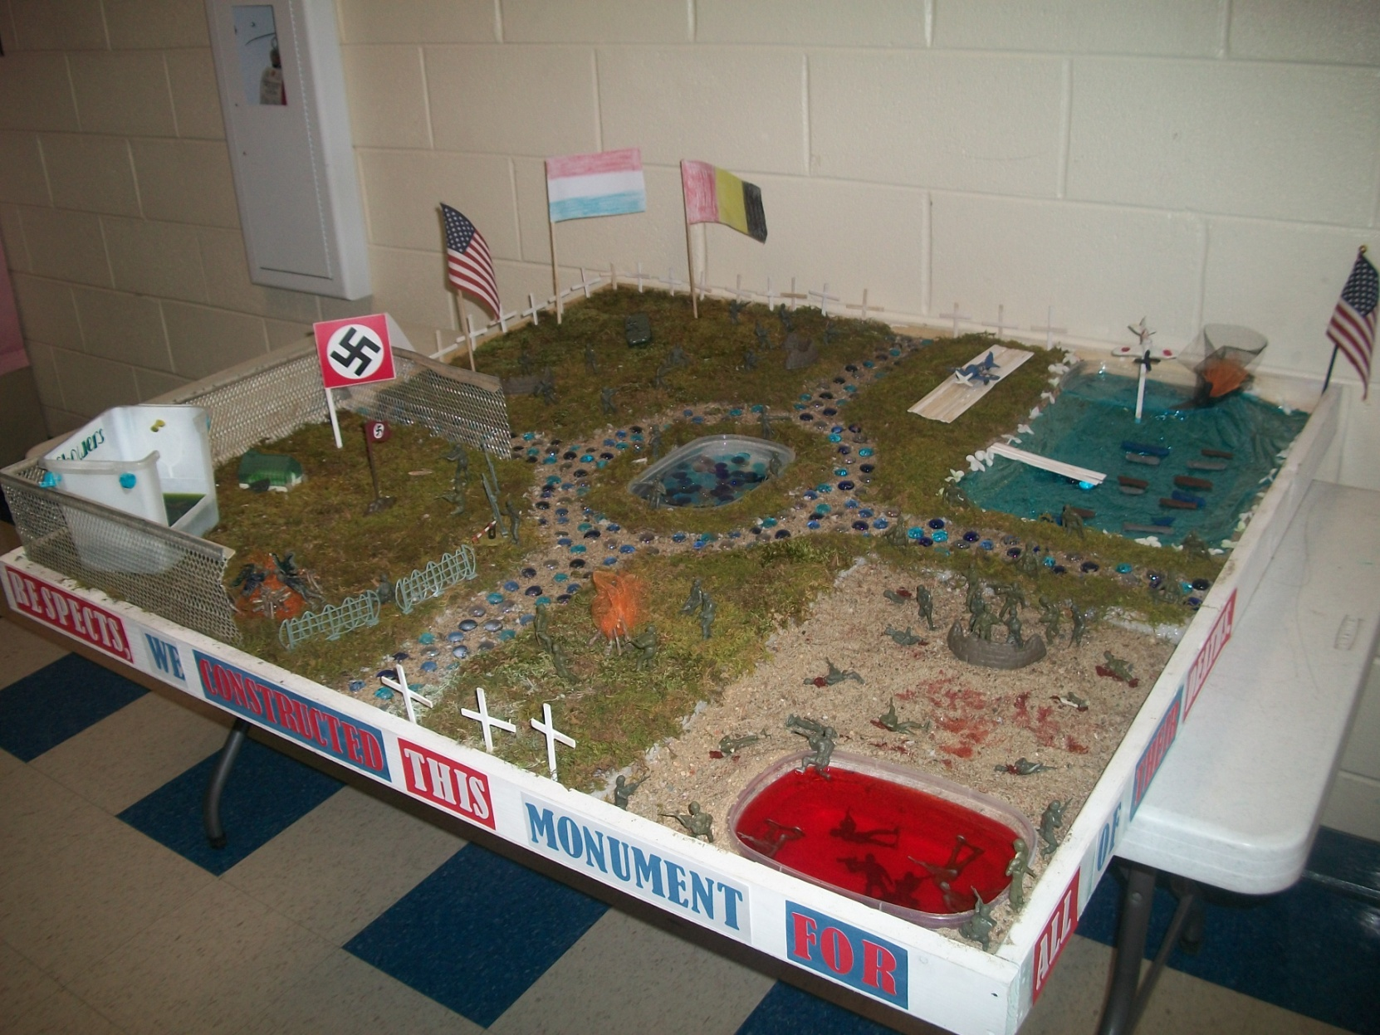
3rd Place (1 point from198 away from 2nd place)

Slide 6
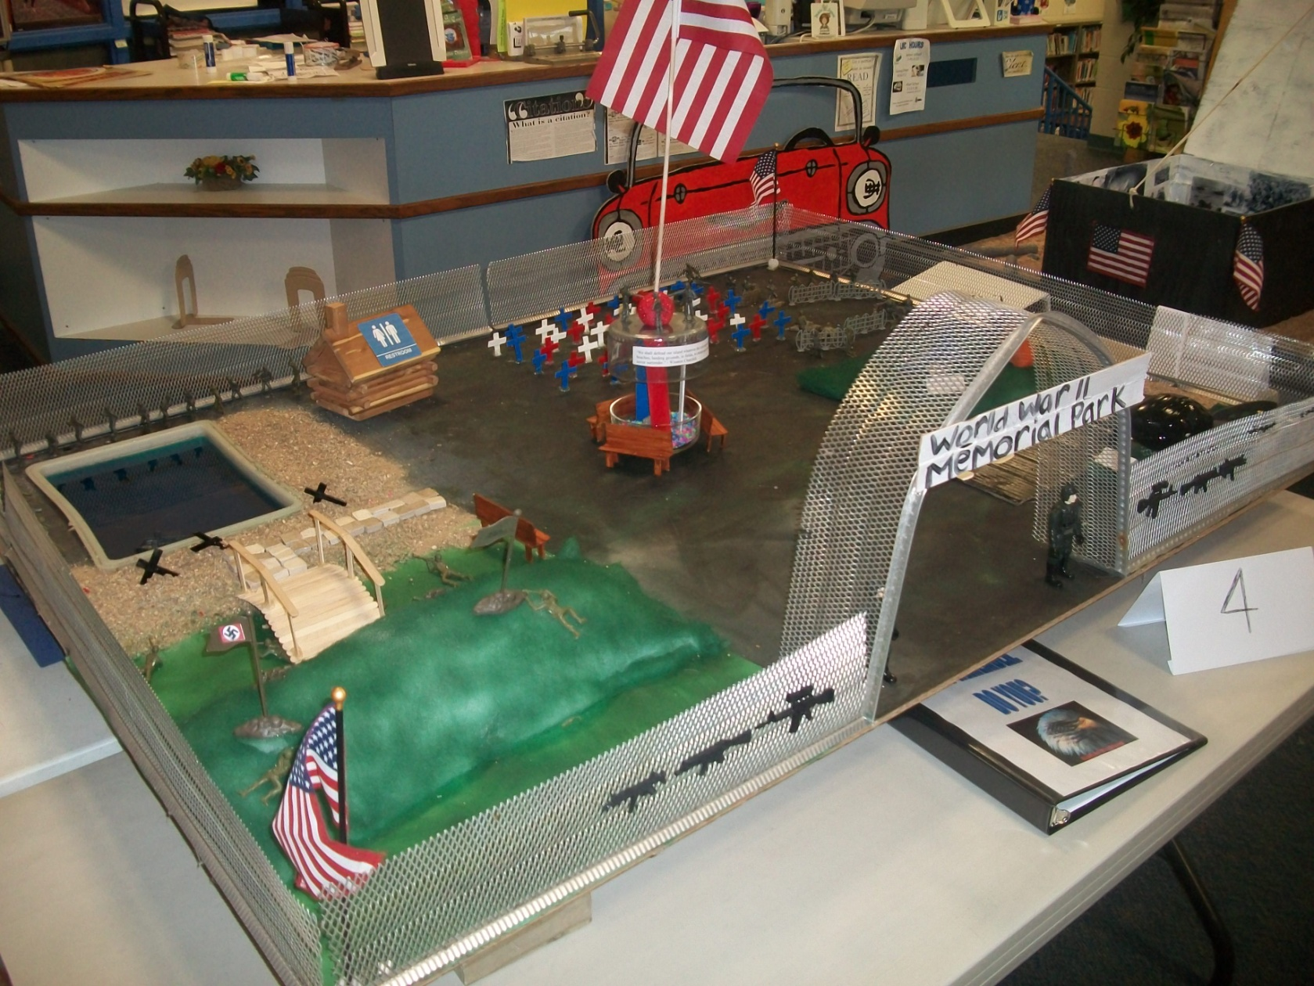
2nd Place (w/ 198 points)

Slide 7
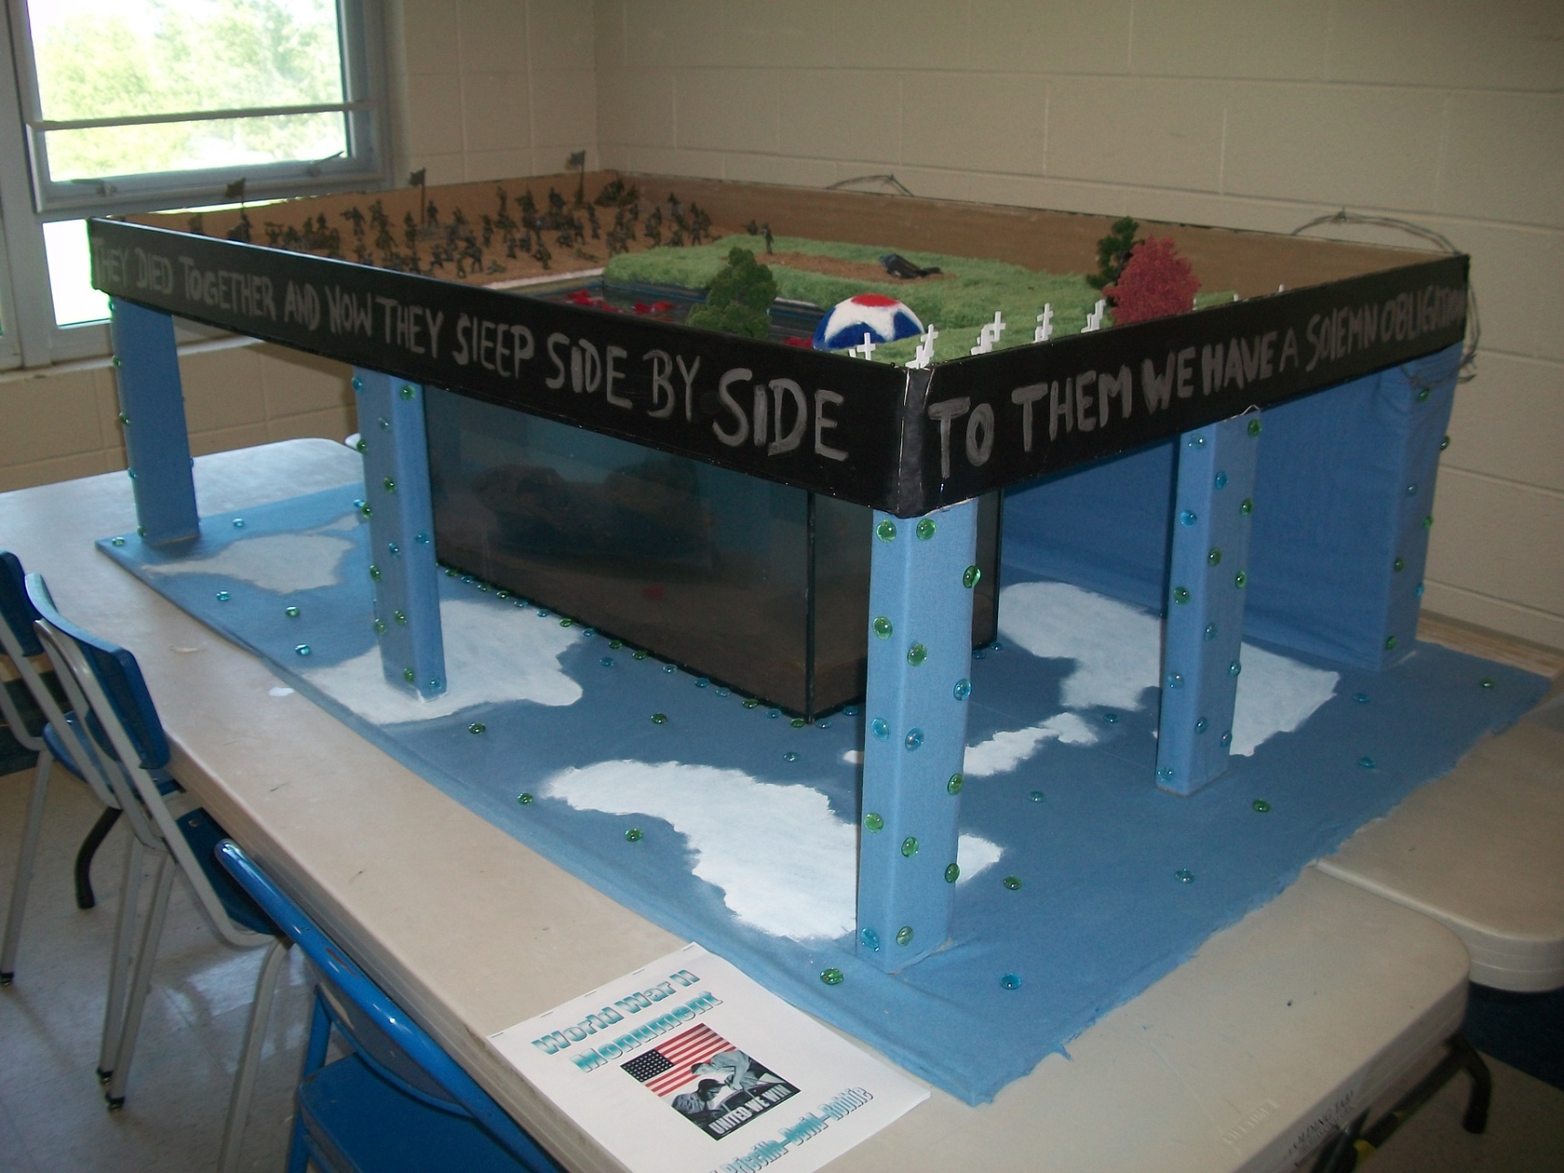
1st Place

