Slide 1
Today’s Tasks
As I am taking attendance
If you were absent yesterday, make sure you have your 5.4 Notes downloaded.
If you were here yesterday, find your 5.4 notes you filled in yesterday and pull those up.
Class Activities Today
Fill out the survey on the homepage of my website
Complete your message board assignment from yesterday
Fill in 5.4 Notes during the “Teddy Roosevelt’s Square Deal Lecture”

Slide 2
As I am Taking Attendance
Open up your 5.4 Notes – we will finish filling them out with the information in this slide show
Download your Unit 5 Study Guide
We will play Jeopardy towards the end of class today prepare for a short quiz tomorrow.

Slide 3
Teddy Roosevelt’s Square Deal
9.3 Notes

Slide 4
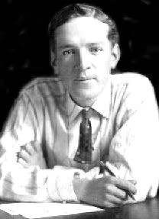
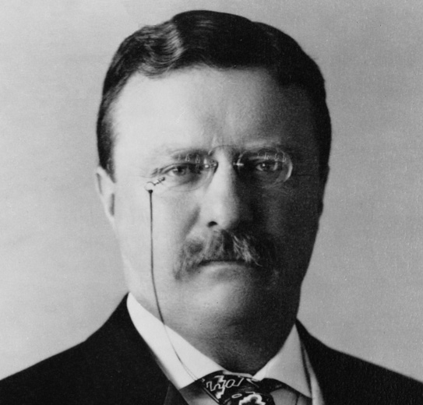
Muckraker in Action
The Jungle written by Upton Sinclair influenced Teddy Roosevelt to make changes in laws and the meat packing industry

Slide 5
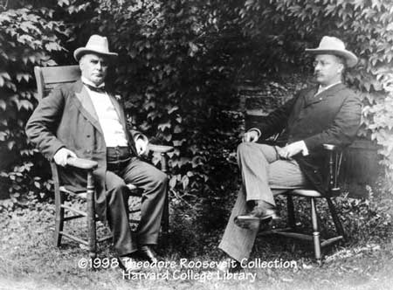
A Rough-Riding President
Teddy was governor of New York and was not popular with the city bosses
Remember Ward Bosses?
They encouraged him to run for Vice President for McKinley
What is the job of the Vice President of the United States?
McKinley became president and Roosevelt was effectively silenced

Slide 6
A Rough-Riding President
McKinley dies - 6 months into his 2nd term in office.
Roosevelt becomes the most powerful man in the US Government
Youngest President in the United States
Kennedy was the youngest ELECTED President
Started and led the Rough Riders
Volunteer cavalry that fought in the battle of San Juan Hill during a war with Spain.

Slide 7
Critical Thinking Question
Roosevelt said, “It is the duty of the president to act upon the theory that he is the steward of the people, and . . . To assume that he has the legal right to do whatever the needs of the people demand, unless the Constitution or the laws explicitly forbid him to do it.”
Do you agree or disagree with this quote? What parts do you like best or least? Why?

Slide 8
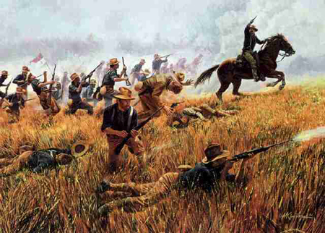
A Rough-Riding President
Roosevelt said that the presidency is a “Bully Pulpit”
The president should influence the media and congress to see that the people of the country are treated fairly
Square Deal
Term the Roosevelt used to describe how people should be treated . . . A fair deal = a Square Deal

Slide 9
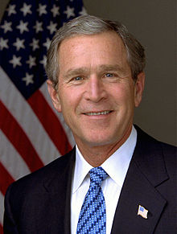
Interesting Fact
Roosevelt wrote 44 books in his life. His first book was published at the age of 24
Who is the only President who never published a book or paper before he became President?

Slide 10
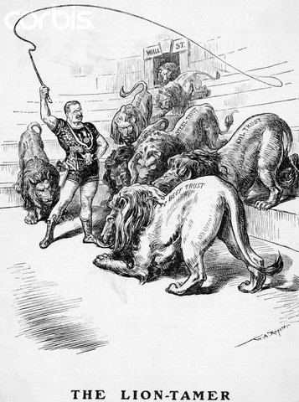
Using Federal Power
Trustbusting
Trusts – companies that owned stocks in many other companies
Companies would lower prices to drive other companies out of business and then when they were the only business left they would drive up prices higher than they had been previously
Examples: Standard Oil Company, Railroad Companies
Teddy ordered the Supreme Court to investigate oil companies and filed 44 law suits against harmful companies
Roosevelt didn’t see all trusts as harmful

Slide 11
Ordered Sharing
“A man who has never gone to school may steal from a freight car; but if he has a university education, he may steal the whole railroad.”
“A vote is like a rifle; its usefulness depends upon the character of the user.”
“Behind the ostensible government sits enthroned an invisible government owing no allegiance and acknowledging no responsibility to the people.”
“Far better is it to dare mighty things, to win glorious triumphs, even though checkered by failure... than to rank with those poor spirits who neither enjoy nor suffer much, because they live in a gray twilight that knows not victory nor defeat.”
“I am a part of everything that I have read.”

Slide 12
Using Federal Power
1902 Coal Strike
Coal workers went on strike and the owners refused to talk with the coal workers
5 months into the strike the coal reserves went low and prices were rising
The strike was threatening the interests of the country
Roosevelt decides to mediate the bargain between the owners and workers
He sets a Precedent for future Presidents
When a strike threatens the welfare of the public, the government is expected to intervene

Slide 13
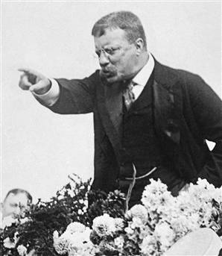
Roosevelt’s Personality
“[The mine operators had] extraordinary stupidity and bad temper . . . Only the dignity of the presidency kept him from taking one owner by the seat of the breeches and tossing him out the window”

Slide 14
Using Federal Power
Railroad Regulation
Roosevelt convinced Congress to create the Interstate Commerce Commission
set fixed prices for railroad freight transportation
Eliminated free passes and bribes to railroad companies

Slide 15
Health and the Environment
Meat Inspection Act
Dictated strict cleanliness requirements for meat packing industry
Established inspectors
Pure Food and Drug Act
Made it illegal to sale harmful products
Required truthful labels giving accurate information to consumers about products
FDA (Food and Drug Administration)
Conservation
Roosevelt created many wildlife preserves
Created conservation departments for natural resources and especially water
What is the difference between Conservation and Preservation?

Slide 16
Critical Thinking Journal
What is more important? Conservation or Preservation?

Slide 17
Roosevelt and Civil Rights
Greater than most but lacking in many areas
Appointed African Americans to several positions in the south angering some southerners
Dismissed, without investigation, an African American Regiment when it was accused of conspiracy
Invited Booker T. Washington to the White House
Did not invite WEB DuBois
WEB Dubois created the NAACP
National Association for the Advancement of Colored People

